Slide 1
FAMILY TREE
-Nothing is too great for us to tackle together

Slide 2
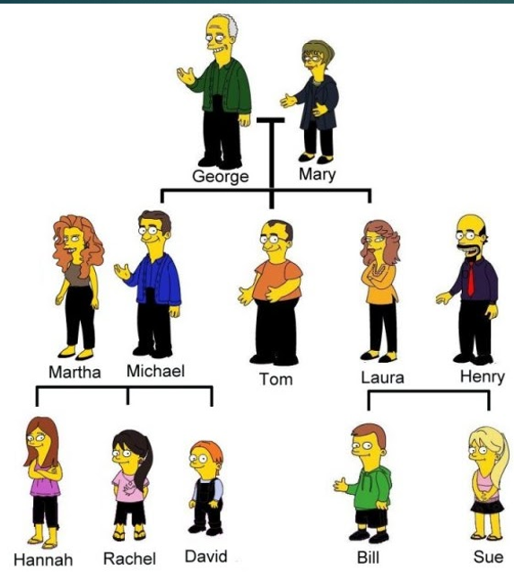
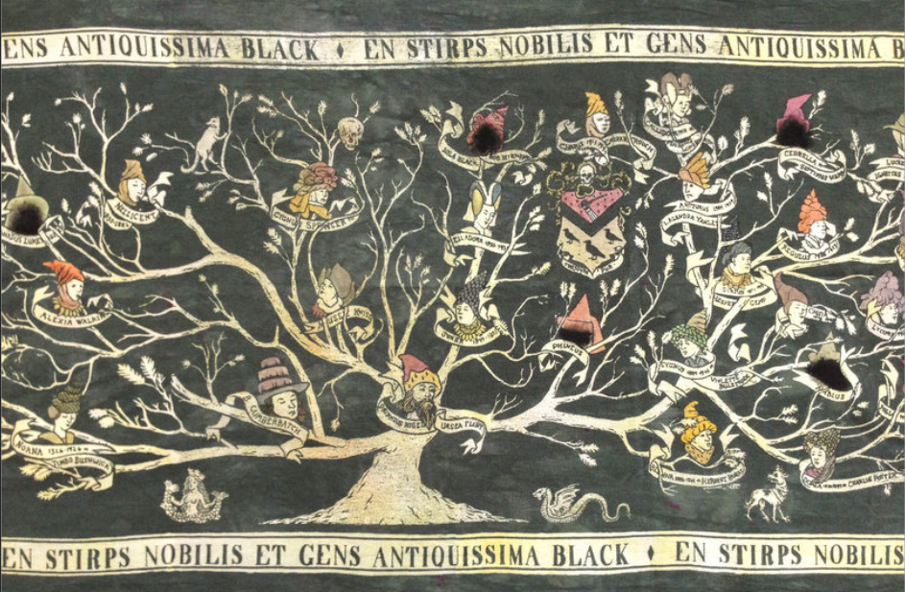
Abstract
WHAT IS A FAMILY TREE?
Taken literally, it's a record of your lineage, showing the members of your family throughout recent, and even distant, history.
The purpose of this to tell us who our family is, how it has grown, and where you originally came from. Establishing lineage can sometimes impact inheritance, which can be fractured or changed by war, disaster, disease, immigration and other life events. Family trees also help medical professionals answer questions.

Slide 3
FEATURES
Establish relationships
Specify genders in relationship
Display personal details
Edit relationships
Privacy options
Search people by name
Printing
Import, Exports to CSV, GEDCOM format

Slide 4



TECHNOLOGIES
Electron
Node
JS
HTML
CSS , Bootstrap
TECHNOLOGIES

Slide 5
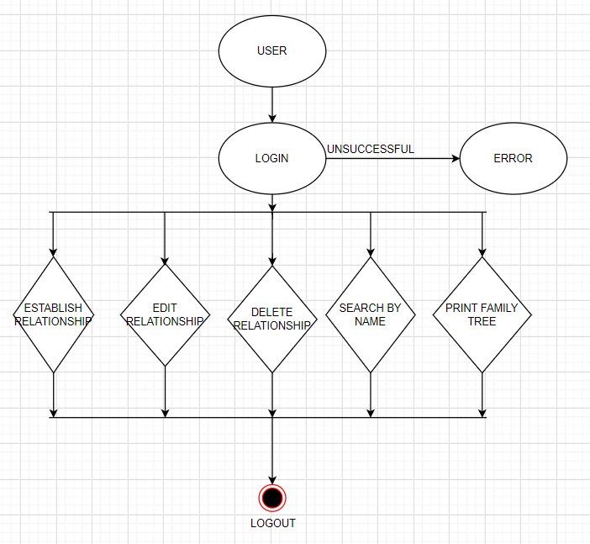
FLOW CHART
https://drive.google.com/file/d/13n9cpeBTciX37szRQ87qlkEqfXqLornj/view?usp=sharing

Slide 6


HOW ARE WE VALIDATING?
This Photo by Unknown Author is licensed under CC BY

Slide 7
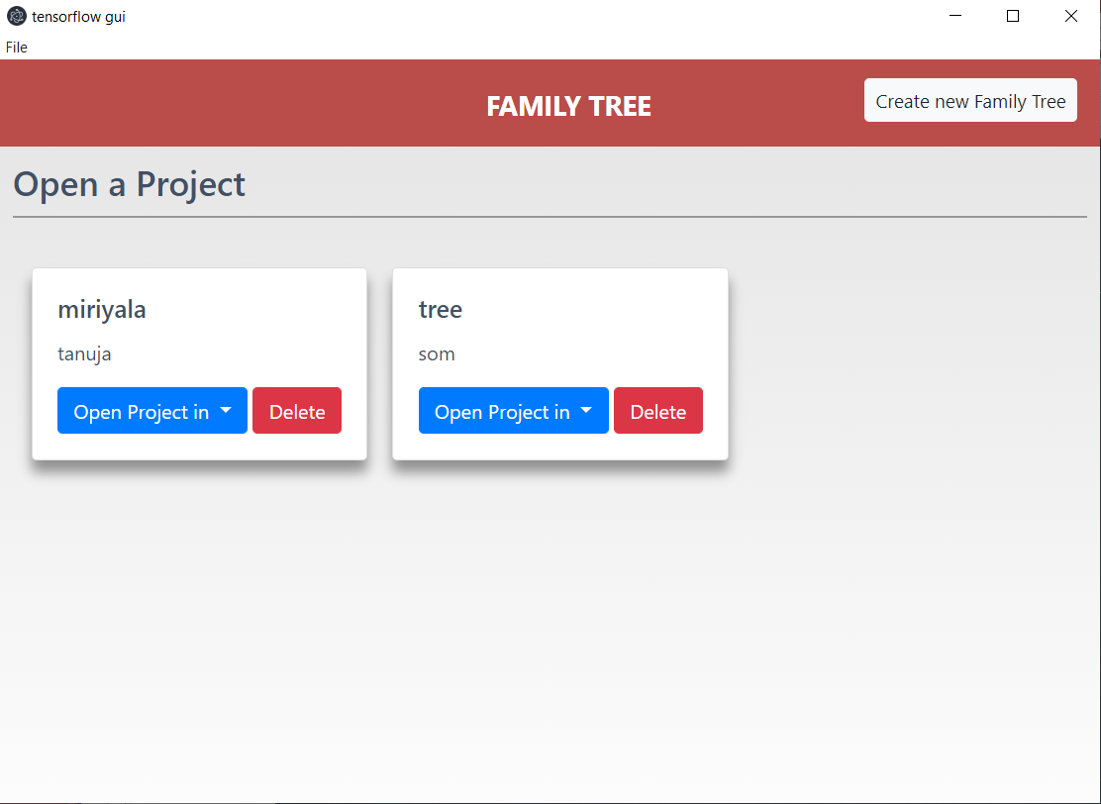

Slide 8
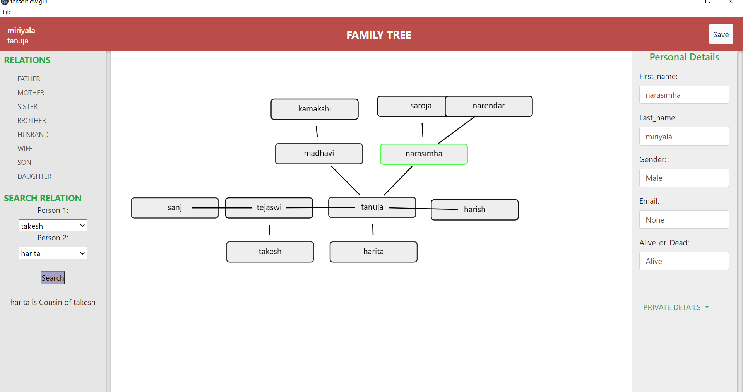
DEMO

Slide 9
THANK YOU

